Slide 1
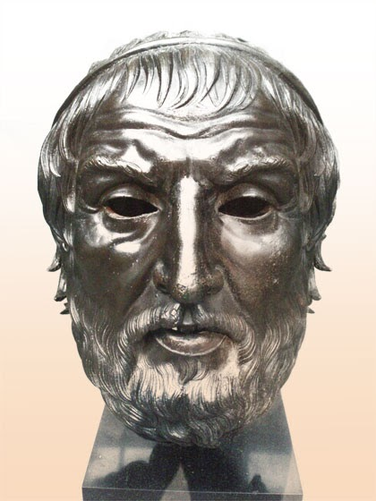
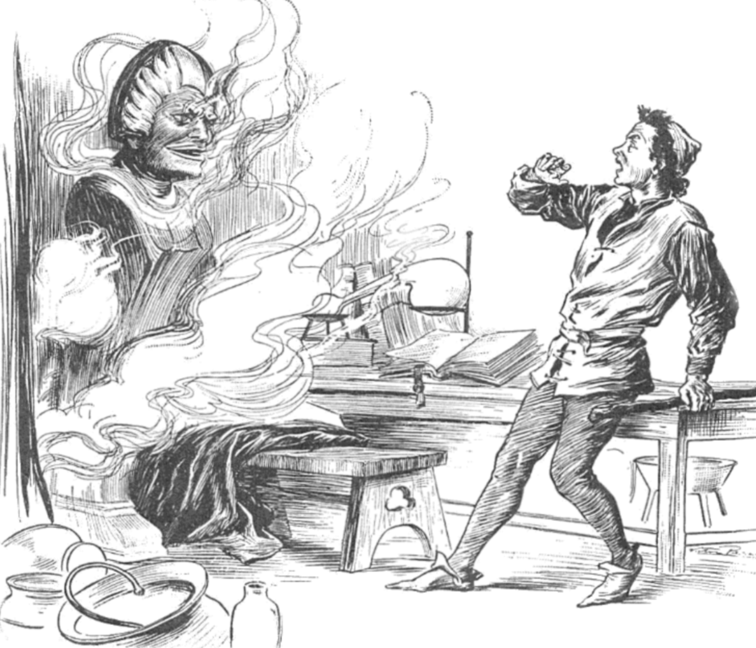
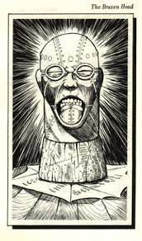
BRAZEN HEAD
ANSH MITTAL & ALPA TIWARI
CSE(DATA SCIENCE)
4TH SEMESTER (2nd year)
SECTION-B
2201331540041 AND 2201331540027

Slide 2
PROBLEM STATEMENT
A legendary automaton in the early modern period whose ownership was ascribed to late medieval scholars.
This chatbot, originally credited as witchcraft and magical, aims not only to answer as its original response of "yes" and "no", but also believes in answering in around 90 characters of text.

Slide 3
Literature Review
The first account of a talking head used to give its owner answers to his questions appears in William of Malmesbury's c. 1125 History of the English Kings, in a passage where he collects various rumours surrounding the polymath Pope Sylvester II, who was said to have travelled to Al-Andalus and stolen a tome of secret knowledge, whose owner he was only able to escape through demonic assistance.
He was said to have cast the head of a statue using his knowledge of astrology. It would not speak until spoken to, but then answered any yes/no question put to it.

Slide 4
AI-Tech
Trained on large amounts of data and use ML to intelligently generate a wide range of non-scripted, conversational responses to human text.

Slide 5
TECHNOLOGIES USED
HTML
CSS
JAVASCRIPT
Python
OpenAI API KEYS
Firebase Documentation

Slide 6
MONETIZATION POLICY
VIA GOOGLE ADS
AND
FUTURE INTRODUCTION OF PRO VERSION

Slide 7
Bibliography
Wikipedia
Vatican Archives
Firebase Documentation
OpenAI Documentation
IEEE Transactions on Pattern Analysis and Machine Intelligence.
Stack Overflow
GitHub Repository for Chatbot Development Framework
Dharohar Bhavan Archives

